Slide 1
Dimensionality Reduction and Neural Networks

Slide 2
Dimensionality Reduction
Principal Component Analysis (PCA
Feedforward Neural Networks
Multi-layer Perceptron (MLP)
Convolutional Neural Networks
Recurrent Neural Networks.

Slide 3
🧠 1. Dimensionality Reduction
Dimensionality reduction simplifies datasets by reducing the number of input variables (features) while preserving essential information.
Imagine you have a huge coloring book with 100 crayons.
But most pictures only need 3–4 colors.
Dimensionality reduction helps us find the most important "colors" (features) and ignore the rest.
Why It’s Useful
Makes data easier to visualize
Speeds up learning
Removes noise

Slide 4
📉 2. Principal Component Analysis (PCA)
PCA finds new axes (directions) that best capture the spread of data.
It rotates the data to line up with these directions and drops the least important ones.
PCA finds new axes (principal components) that capture the most variance in the data.
It rotates the data to align with these axes and drops the least informative ones.
🧮 Technical Insight:
First component captures max variance
Second is orthogonal and captures next highest variance
Components are linear combinations of original features

Slide 5
🧠 Intuition: What PCA Does
Imagine you have data points in a high-dimensional space (e.g., age, income, height, etc.).
PCA finds new axes (directions) that:
Capture the maximum variance in the data,
Are uncorrelated with each other,
And allow you to reduce dimensions while preserving most of the information.

Slide 6
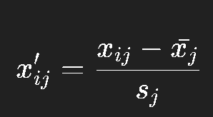
⚙️ Step-by-Step: How PCA Works
🧠 Intuition
We’re transforming each feature so that:
This eMean = 0
Standard deviation = 1
nsures that all features contribute equally to PCA, regardless of their original scales.
🧩 Step 1: Standardize the Data
PCA is sensitive to scale — so we first make each feature have:
Mean = 0
Standard deviation = 1
Mathematically:
Symbol | Meaning | Example
 | The original value of feature ( j ) for sample ( i ) | The Age of the 5th passenger
 | The mean (average) of feature ( j ) across all samples | The average Age of all passengers
 | The standard deviation of feature ( j ) | How spread out the Age values are
 | The standardized (scaled) value | The new “normalized” version of Age for that passenger

Slide 7
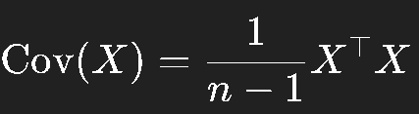

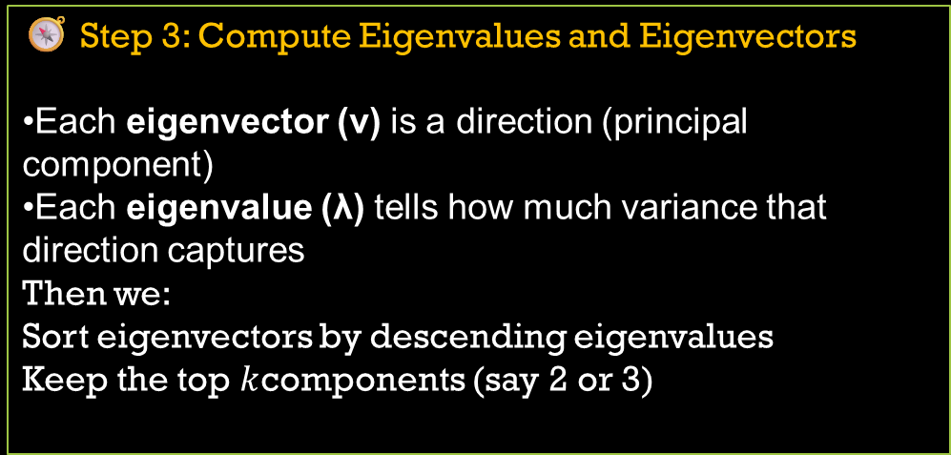
🧭 Step 3: Compute Eigenvalues and Eigenvectors
Each eigenvector (v) is a direction (principal component)
Each eigenvalue (λ) tells how much variance that direction captures
Then we:
Sort eigenvectors by descending eigenvalues
Keep the top $k$components (say 2 or 3)
🧮 Step 2: Compute the Covariance Matrix
This matrix captures relationships between features - how they vary together.
If two features are strongly correlated, PCA will detect it.

Slide 8
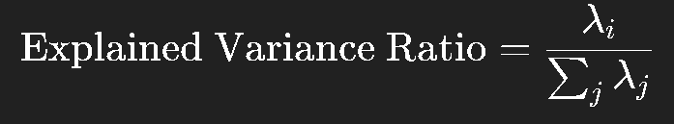
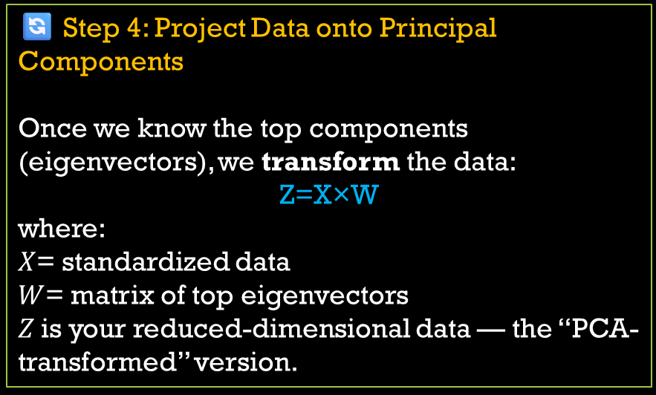
🔄 Step 4: Project Data onto Principal Components
Once we know the top components (eigenvectors), we transform the data:
Z=X×W
where:
$X$= standardized data
$W$= matrix of top eigenvectors
$Z$is your reduced-dimensional data — the “PCA-transformed” version.
📈 Step 5: Explained Variance Ratio
This shows how much information (variance) each principal component preserves.
Usually, the first few components explain most of the variance — so we can safely drop the rest.

Slide 9
Step | Operation | Output
1 | Standardize data | Zero-mean, unit-variance data
2 | Compute covariance matrix | Feature correlations
3 | Eigen decomposition | Principal components
4 | Sort eigenvectors by eigenvalue | Most informative directions
5 | Project data | Reduced feature set

Slide 10
📊 Example: 12_PCA_DEMO.py
# 📚 Import required libraries
import pandas as pd
from sklearn.preprocessing import StandardScaler
from sklearn.decomposition import PCA
import matplotlib.pyplot as plt
import seaborn as sns
# 🧭 Step 1: Load the Titanic dataset
url = "https://raw.githubusercontent.com/datasciencedojo/datasets/master/titanic.csv"
df = pd.read_csv(url)
# 🧼 Step 2: Select relevant features
# We'll use numerical + encoded categorical features
features = ['Pclass', 'Sex', 'Age', 'SibSp', 'Parch', 'Fare', 'Embarked']
df = df[features + ['Survived']]
# Handle missing values
df['Age'] = df['Age'].fillna(df['Age'].median())
df['Embarked'] = df['Embarked'].fillna(df['Embarked'].mode()[0])

Slide 11
# Encode categorical variables
df['Sex'] = df['Sex'].map({'male': 0, 'female': 1})
df = pd.get_dummies(df, columns=['Embarked'], drop_first=True)
# Define feature matrix (X) and target (y)
X = df.drop('Survived', axis=1)
y = df['Survived']
# ⚖️ Step 3: Standardize the data
scaler = StandardScaler()
X_scaled = scaler.fit_transform(X)
# 🎯 Step 4: Apply PCA
pca = PCA(n_components=2)
principal_components = pca.fit_transform(X_scaled)
# Create DataFrame for visualization
pca_df = pd.DataFrame(data=principal_components, columns=['PC1', 'PC2'])
pca_df['Survived'] = y.values

Slide 12
# 📊 Step 5: Visualize the PCA results
plt.figure(figsize=(8,6))
sns.scatterplot(
data=pca_df,
x='PC1',
y='PC2',
hue='Survived',
palette=['red', 'green'],
alpha=0.7
)
plt.title('PCA of Titanic Dataset')
plt.xlabel(f'PC1 ({pca.explained_variance_ratio_[0]*100:.2f}% Variance)')
plt.ylabel(f'PC2 ({pca.explained_variance_ratio_[1]*100:.2f}% Variance)')
plt.show()
# 📈 Step 6: Check explained variance
print("Explained variance ratio:", pca.explained_variance_ratio_)

Slide 13
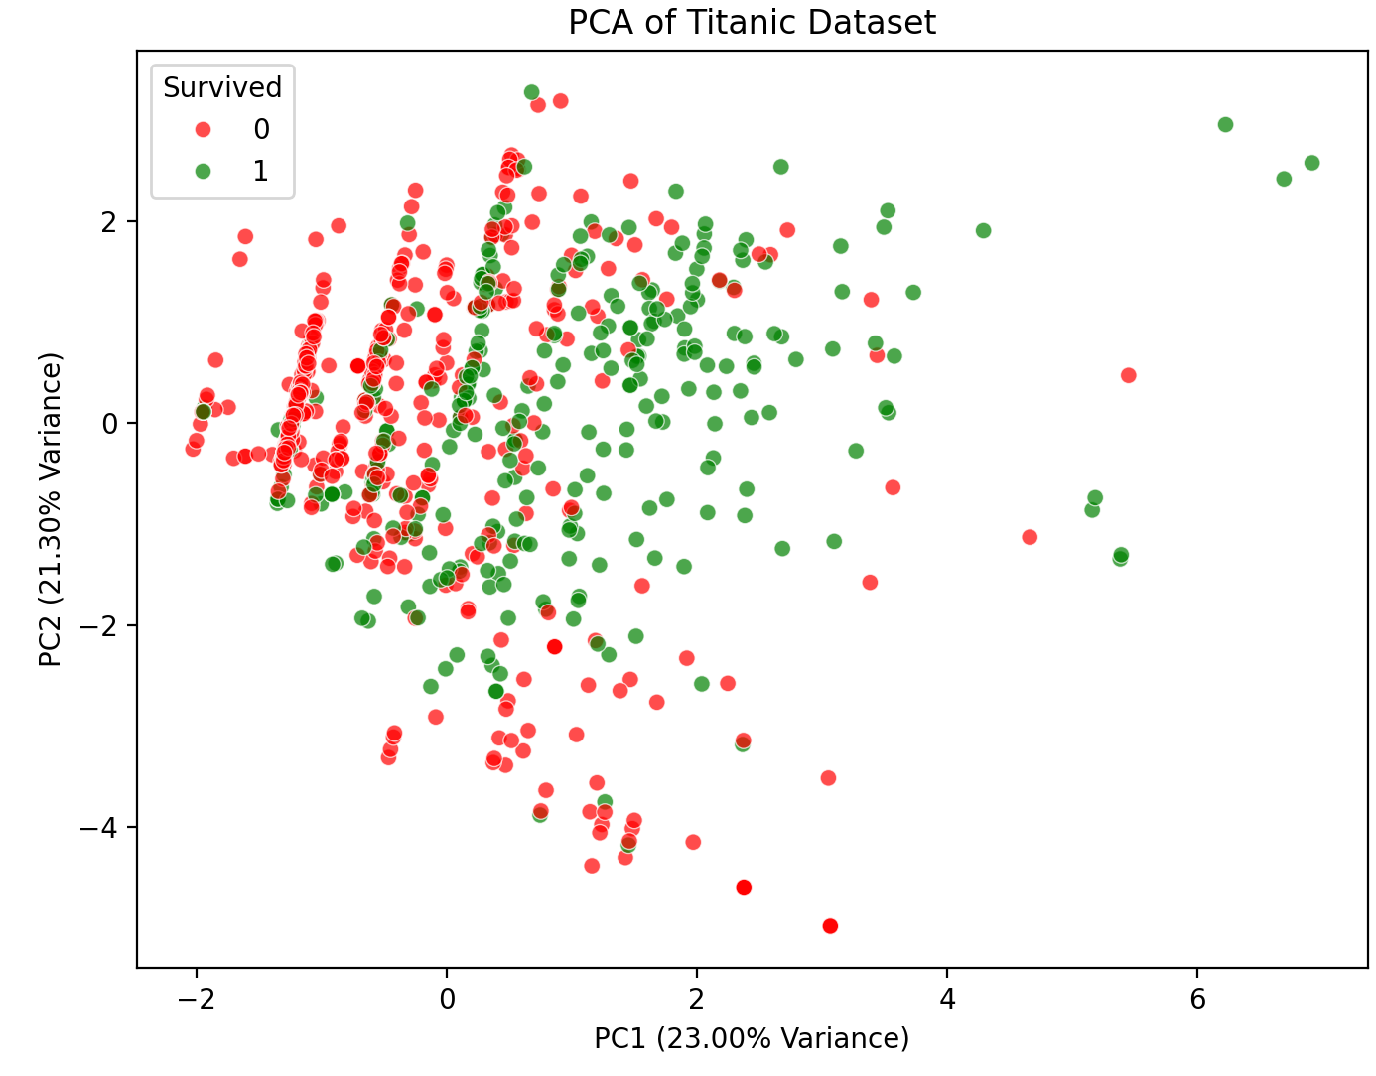
the PCA algorithm reduces the Titanic dataset’s features (like Age, Fare, Sex, etc.) to 2 principal components (PC1 and PC2).
Then, we visualize these 2 components in a 2D scatter plot.
Each dot = one passenger.
Each dot’s color = whether that passenger survived (green) or did not survive (red).
The color (hue = Survived) is not part of PCA.
It’s just for interpretation — to help us see if PCA’s projection separates survivors and non-survivors.
PCA is unsupervised, meaning it doesn’t know about “Survived” at all.
We just color it afterward to visualize how informative the components are.

Slide 14
If PCA’s projection shows some clustering by color, it means:
The reduced components still retain meaningful information about survival,
i.e., the features chosen (Pclass, Age, Sex, etc.) capture survival patterns.
If the plot looks mixed, it means:
The linear variance captured by PCA doesn’t clearly separate survivors from non-survivors,
So PCA found directions of maximum variance, not necessarily class separation.
If survivors (green) cluster separately from non-survivors (red),
PCA captured useful structure in the data.
If all points are mixed, survival might depend on nonlinear factors that PCA can’t capture.

Slide 15
Even though PCA reduces dimensions, the visualization:
Helps you see hidden structure in your data,
Lets you detect outliers, as points that don’t align with the main “structure” of the data.
And gives an intuitive sense of separability between classes (even though PCA doesn’t use the labels).
PCA → reduces features to 2 new numeric axes (PC1, PC2).
Scatter plot → visualizes the reduced data.
Colors → show how well PCA’s projection separates survival classes (added after PCA for insight).

Slide 17
3. Deep learning
It is a type of machine learning that uses artificial neural networks with multiple layers to learn from vast amounts of data, much like the human brain.
This "deep" structure allows it to identify increasingly complex patterns and features in data, enabling machines to perform tasks like image recognition, natural language processing, and autonomous driving.
Unlike some machine learning techniques, it can process unstructured data without needing manual pre-processing and improves its accuracy over time as it analyzes more data.

Slide 18
Working
Inspired by the brain: Deep learning is based on artificial neural networks, which are computational models inspired by the structure and function of the human brain.
Multi-layered structure: These networks consist of multiple layers—an input layer, one or more hidden layers, and an output layer—that process information in stages.
Pattern recognition: Each layer learns to identify different features in the data. For example, an early layer might recognize a basic shape, while a later layer uses that information to identify a more complex object, like a car.
Learning from data: The network is "trained" on large datasets. Through repeated iterations, it adjusts its parameters to improve its ability to make predictions or classifications.
Self-correction: The system can identify patterns and solutions independently, even with unstructured or unlabeled data, and becomes more accurate as it is exposed to more examples.

Slide 19
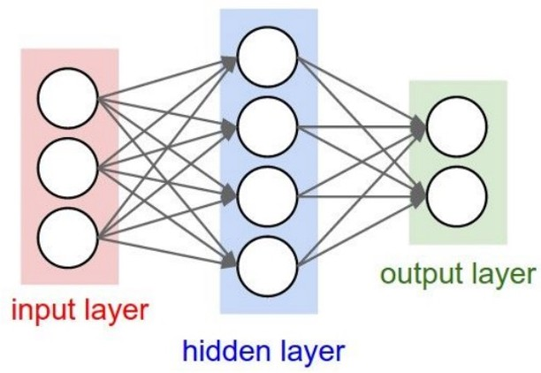
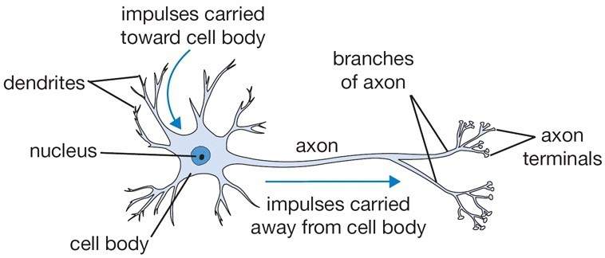
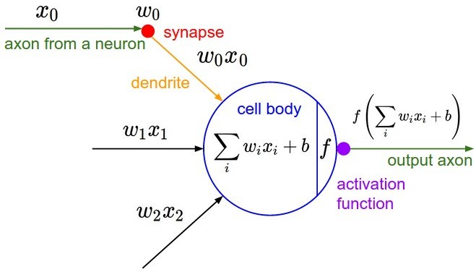
Artificial Neurons:
An Inspiration from Nature
A single node in your neural network
  Accept information from multiple inputs
  Transmit information to other neurons
A neuron’s function is inspired by its biological counterpart:
  Apply some function on inputs signals
  If output of function over threshold, neuron “fires”
Slide Source: Johns Hopkins, University

Slide 20
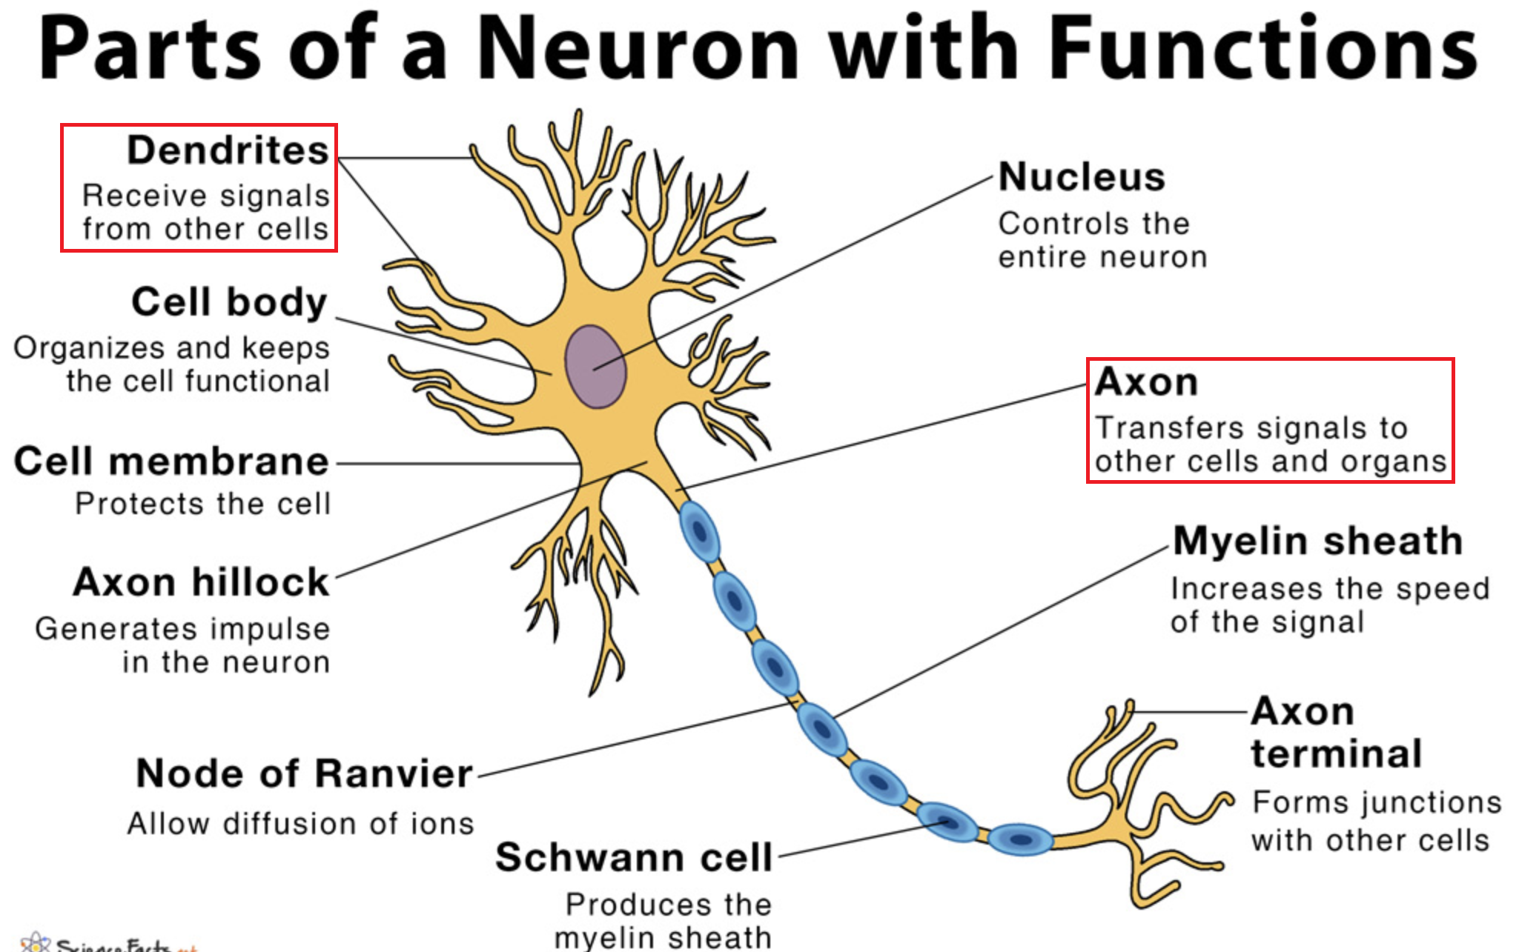
Brain neuron

Slide 21
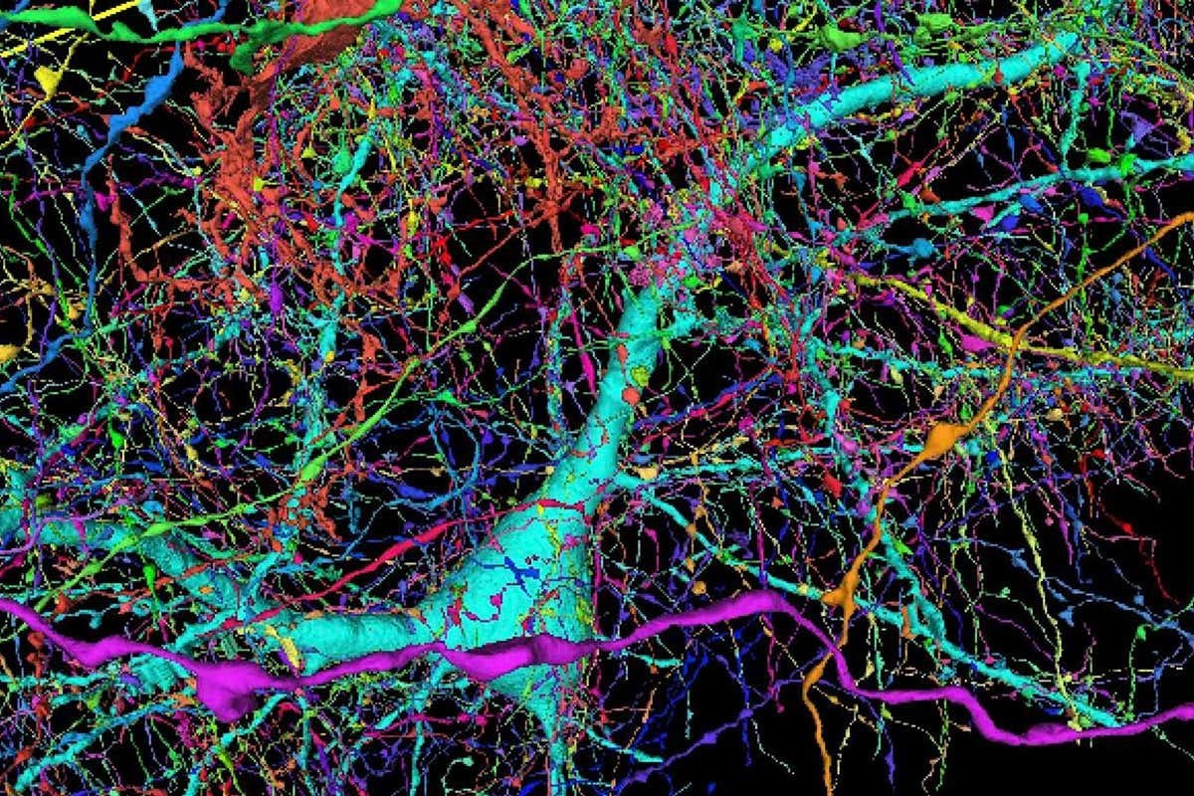
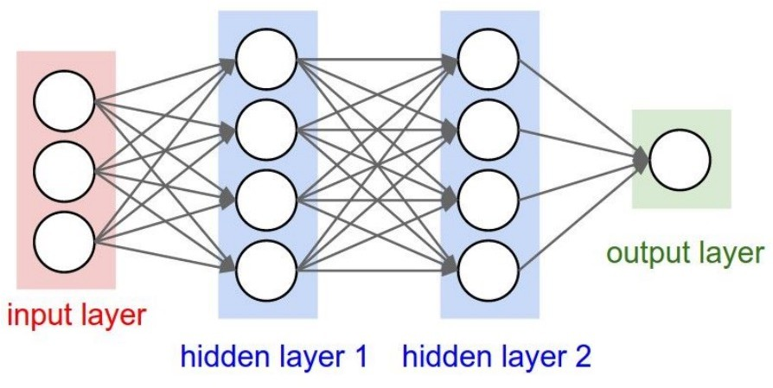
Artificial Neurons: Not Quite Analogous to Nature
Neurons in an artificial neural network: organized based on a highly regular structure for computational efficiency
Biological neurons: complex connectivity
Source: Google Brain Map
Slide Source: Johns Hopkins, University

Slide 22
History of Neural Networks
A single node in your neural network
  Accept information from multiple inputs
  Transmit information to other neurons
A neuron’s function is inspired by its biological counterpart:
  Apply some function on inputs signals
  If output of function over threshold, neuron “fires”
Single-layer neural networks (1943-1969)
Symbolic AI & knowledge engineering (1970-1985)
Multi-layer NNs and symbolic learning (1985-1995)
Shallow statistical learning/probabilistic models (1995-2010)
Deep networks and self-supervised learning (2010-?)

Slide 23
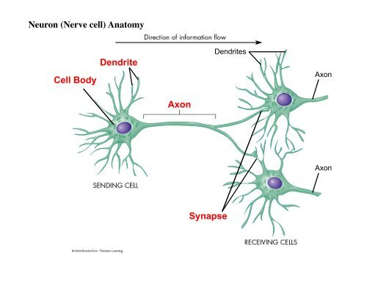
Neural Network
An Artificial Neural Network (ANN) models the relationship between a set of input signals and an output signal using a model derived from our understanding of how a biological brain responds to stimuli from sensory inputs.
Just as a brain uses a network of interconnected cells called neurons to create a massive parallel processor, ANN uses a network of artificial neurons or nodes to solve learning problems.

Slide 24
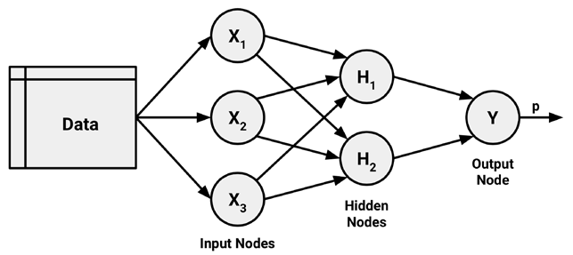
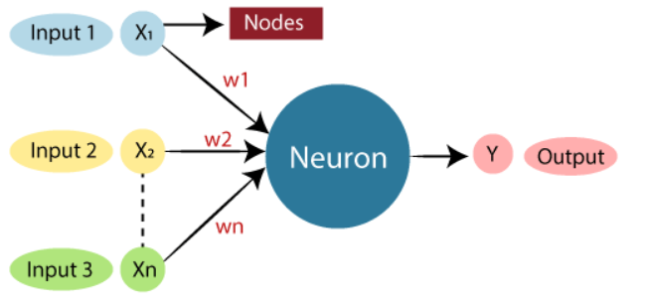
Artificial Neural Network
The study of artificial neural networks (ANNs) has been inspired in part by the observation that biological learning systems are built of very complex webs of interconnected neurons in brains.
ANNs are built out of a densely interconnected set of simple units, where each unit takes a number of real-valued inputs and produces a single real-valued output.

Slide 25
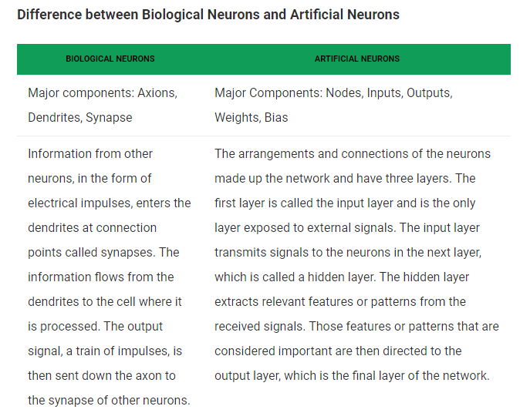

Slide 26
Neural networks use neurons defined this way as building blocks to construct complex models of data. Although there are numerous variants of neural networks, each can be defined in terms of the following characteristics:
An activation function, which transforms a neuron's combined input signals into a single output signal to be broadcasted further in the network.
A network topology (or architecture), which describes:
  the number of neurons in the model
  the number of layers and manner in which they are connected.
The training algorithm that specifies how connection weights are set in order to inhibit or excite neurons in proportion to the input signal.

Slide 27
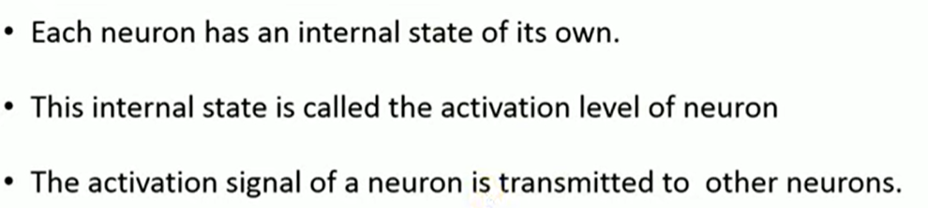

Slide 28
Advantage of Using Artificial Neural Networks
ANNs is used for problems having the target function output may be discrete-valued, real-valued, or a vector of several real- or discrete-valued attributes.
ANN learning methods are quite robust to noise in the training data. The training examples may contain errors, which do not affect the final output.
It is generally used where the fast evaluation of the learned target function may be required.
ANNs can bear long training times depending on factors such as the number of weights in the network, the number of training examples considered.

Slide 29
Characteristics of Artificial Neural Network
It is neurally implemented mathematical model
It contains huge number of interconnected processing elements called neurons to do all operations
Information stored in the neurons are basically the weighted linkage of neurons
The input signals arrive at the processing elements through connections and connecting weights.
It has the ability to learn , recall and generalize from the given data by suitable assignment and adjustment of weights.
The collective behavior of the neurons describes its computational power, and no single neuron carries specific information .
Notes:
. weights are the real values that are attached with each input/feature and they convey the importance of that corresponding feature in predicting the final output

Slide 30
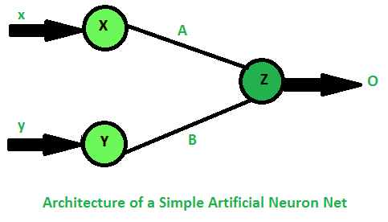
How simple neuron works
Let there are two neurons X and Y which is transmitting signal to another neuron Z .
Then , X and Y are input neurons for transmitting signals and Z is output neuron for receiving signal.
The input neurons are connected to the output neuron , over a interconnection links ( A and B ) as shown in figure .
For above neuron architecture , the net input has to be calculated in the way: I = xA + yB
where x and y are the activations of the input neurons X and Y .
The output z of the output neuron Z can be obtained by applying activations over the net input .
O = f(I)

Slide 31
Application of Neural Network
Computer Vision
Facial Recognition: Used for security and unlocking devices by matching faces to images in a database.
Image Classification: Identifying objects, scenes, and details within images.
Medical Imaging: Analyzing medical scans like X-rays, CT scans, and ultrasounds to aid in diagnosis.
Autonomous Vehicles: Processing data from sensors to help with navigation and decision-making.

Slide 32
Natural Language Processing (NLP)
Chatbots and Virtual Agents: Creating automated systems that understand and respond to human language.
Machine Translation: Translating text from one language to another.
Sentiment Analysis: Identifying positive or negative sentiment in comments and reviews.
Document Analysis: Summarizing long documents or extracting key information.

Slide 33
Forecasting and Analytics
Weather Prediction: Analyzing historical data to forecast future weather conditions.
Financial Modeling: Predicting stock market movements and other financial trends.
Predictive Analytics: Forecasting customer behavior for marketing, optimizing supply chains, and predicting demand.

Slide 34
Recommendation Systems
E-commerce: Recommending products to users based on their browsing and purchase history.
Streaming Services: Suggesting movies, shows, or music based on user preferences.
Social Media: Recommending content, connections, or products based on user activity.

Slide 35
Other Applications
Fraud Detection: Identifying fraudulent transactions in finance.
Speech Recognition: Converting spoken language into text, used in voice assistants.
Robotics: Enabling humanoid robots to perform complex tasks.
Biomedical Research: Predicting protein folding with high precision.

Slide 36
Network Topology
The ability of a neural network to learn is rooted in its topology, or the patterns and structures of interconnected neurons. Although there are countless forms of network architecture, they can be differentiated by three key characteristics:
The number of layers
Whether information in the network is allowed to travel backward (direction)
The number of nodes within each layer of the network

Slide 37
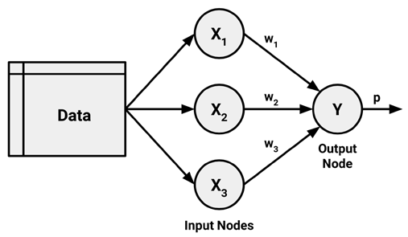
Number of Layers
The input and output nodes are arranged in groups known as layers.
The input nodes process the incoming data exactly as it is received, the network has only one set of connection weights (labeled here as w1, w2, and w3). It is therefore termed a single-layer network
An obvious way to create more complex networks is by adding additional layers. As depicted here, a multilayer network adds one or more hidden layers that process the signals from the input nodes prior to it reaching the output node.
Single Layer Network
Multi-Layer Network

Slide 38
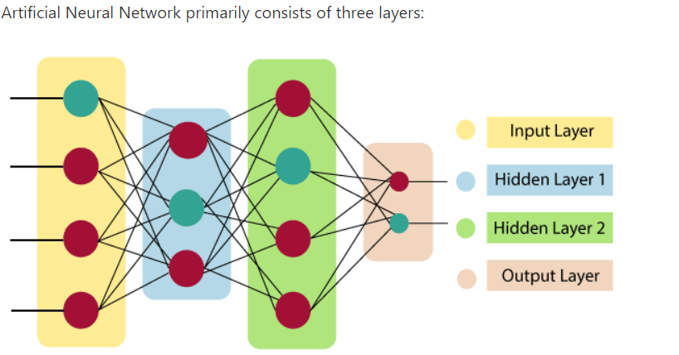

Slide 39

The artificial neural network takes input and computes the weighted sum of the inputs and includes a bias.
This computation is represented in the form of a transfer function.
Notes:
a weight decides how much influence the input will have on the output. Biases, which are constant, are an additional input into the next layer

Slide 40
Direction of Information
You may have noticed that in the prior examples, arrowheads were used to indicate signals traveling in only one direction.
Networks in which the input signal is fed continuously in one direction from connection to connection until it reaches the output layer are called feedforward networks.
In contrast, a recurrent network (or feedback network) allows signals to travel in both directions using loops.
This property, which more closely mirrors how a biological neural network works, allows extremely complex patterns to be learned.
The addition of a short-term memory, or delay, increases the power of recurrent networks immensely.

Slide 41
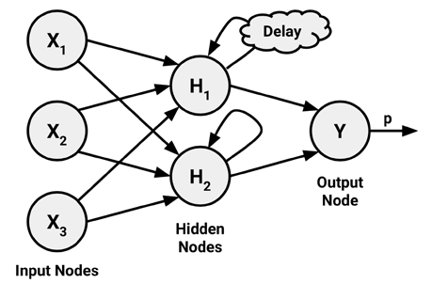
feedforward networks.
recurrent network (or feedback network)

Slide 42
Number of Nodes
The number of input nodes is predetermined by the number of features in the input data.
Similarly, the number of output nodes is predetermined by the number of outcomes to be modeled or the number of class levels in the outcome.

Slide 43
🔁3.1 Feedforward Neural Networks (FNN)
It is a type of artificial neural network where information travels in a single, forward direction from the input layer, through any hidden layers, to the output layer, with no loops or cycles.
A basic neural network where data flows straight from input to output.
A Feedforward Neural Network (FNN) (also called a Multilayer Perceptron – MLP) is the simplest type of artificial neural network.
It’s called feedforward because data flows only in one direction:
→ from input → through hidden layers → to output.
There are no loops or feedback connections.

Slide 44
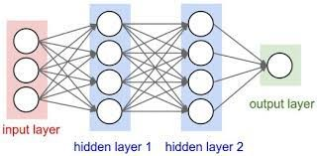
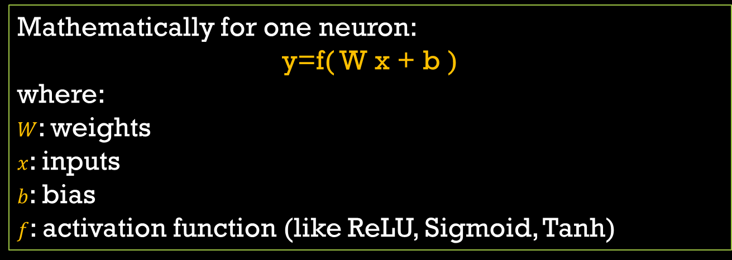
Each neuron (node):
Receives inputs
Multiplies them by weights
Adds a bias
Passes the result through an activation function
Mathematically for one neuron:
y=f( W x + b )
where:
$W$: weights
$x$: inputs
$b$: bias
$f$: activation function (like ReLU, Sigmoid, Tanh)

Slide 45
🎯 Intuition
Each layer learns representations of your data:
The first hidden layer might learn simple patterns (like edges in images or combinations of inputs).
Deeper layers combine these to learn complex relationships.
The output layer gives the final prediction.
📊 Example: Predict Survival on Titanic (Classification)
We’ll train a simple Feedforward Neural Network using Keras (from TensorFlow).

Slide 46
Demonstration
https://playground.tensorflow.org
1. Epoch: An epoch is one complete pass through the entire training dataset.
  Neural networks learn by adjusting weights based on data.
  After each epoch, the model has seen every training example once.
  More epochs = more learning cycles (but too many can cause overfitting).
Python syntax: model.fit(X_train, y_train, epochs=10)
2. Learning Rate: The learning rate controls how much the model updates its weights during training.
  A high learning rate might overshoot the optimal solution.
  A low learning rate might take too long or get stuck.
Python syntax: optimizer = tf.keras.optimizers.Adam(learning_rate=0.01)
Use learning rate schedules or adaptive optimizers (like Adam) to balance speed and stability.

Slide 47
3. Activation Function: An activation function introduces non-linearity into the network, allowing it to learn complex patterns.
4. Regularization: It is a technique to prevent overfitting by penalizing complex models. Types:
  L1 (Lasso): encourages sparsity (some weights become zero)
  L2 (Ridge): discourages large weights
Python syntax:
model.add(Dense(64, activation='relu'))
Function | Output Range | Use Case
ReLU | [0, ∞) | Hidden layers
Sigmoid | (0, 1) | Binary classification
Softmax | (0, 1), sums to 1 | Multi-class classification
Python syntax:
from tensorflow.keras.regularizers import l2
model.add(Dense(64, activation='relu', kernel_regularizer=l2(0.01)))

Slide 48
5. Regularization Rate: The regularization rate (often called lambda or alpha) controls how strong the penalty is.
  A high rate forces the model to be simpler (risk of underfitting).
  A low rate allows more complexity (risk of overfitting).
Syntax: kernel_regularizer=l2(0.01) # 0.01 is the regularization rate
Term | Role in Training | Typical Range / Value
Epoch | # of full passes over training data | 10-100+
Learning Rate | Step size for weight updates | 0.001 to 0.1
Activation | Adds non-linearity to layers | ReLU, Sigmoid, Softmax
Regularization | Prevents overfitting | L1, L2
Regularization Rate | Strength of regularization penalty | 0.0001 to 0.1

Slide 49
🚢 Titanic Survival Prediction with FNN
import pandas as pd
# Step 1: Load Titanic dataset
url = "titanic.csv"
df = pd.read_csv(url)
# Step 2: Select and preprocess features
df = df[['Survived', 'Pclass', 'Sex', 'Age', 'Fare', 'Embarked']]
df.dropna(inplace=True)
# Encode categorical variables
df['Sex'] = df['Sex'].map({'male': 0, 'female': 1})
df['Embarked'] = df['Embarked'].map({'S': 0, 'C': 1, 'Q': 2})

Slide 50
# Step 3: Split data
from sklearn.model_selection import train_test_split
X = df.drop('Survived', axis=1) # separating the features
y = df['Survived'] # target variable
X_train, X_test, y_train, y_test = train_test_split(X, y, test_size=0.2, random_state=42)
# Step 4: Scale features
from sklearn.preprocessing import StandardScaler
scaler = StandardScaler() # mean = 0 and std = 1
X_train_scaled = scaler.fit_transform(X_train)
X_test_scaled = scaler.transform(X_test)

Slide 51
# Step 5: Train Feedforward Neural Network
from sklearn.neural_network import MLPClassifier
model = MLPClassifier(hidden_layer_sizes=(32,16),activation='relu',solver='adam', max_iter=500)
model.fit(X_train_scaled, y_train)
MLP = Multi-Layer Perceptron
1. Input Layer: Receives the 5 features for each passenger.
2. Hidden Layers: This allows the network to learn complex combinations like:
“Young females in 1st class with high fare tend to survive.”
  First hidden layer: 32 neurons
  Second hidden layer: 16 neurons
  Each neuron applies:
    A weighted sum of inputs
    A non-linear activation (ReLU)
3. Output Layer
  1 neuron with sigmoid activation
  Outputs a value between 0 and 1 → interpreted as probability of survival

Slide 52
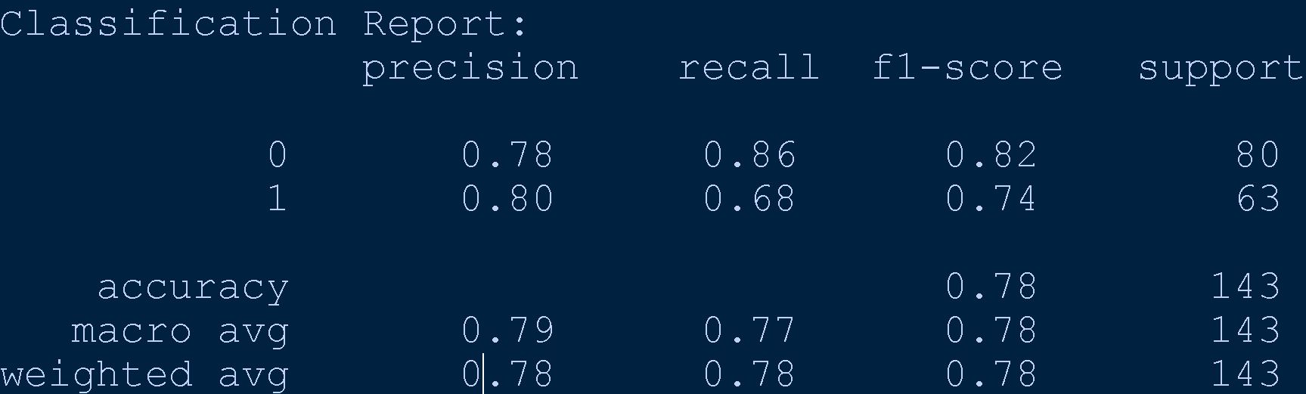
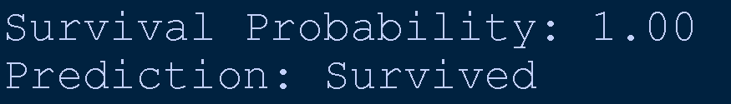
# Step 6: Evaluate
from sklearn.metrics import accuracy_score, classification_report
y_pred = model.predict(X_test_scaled)
print("Accuracy:", accuracy_score(y_test, y_pred))
print("\nClassification Report:\n", classification_report(y_test, y_pred))
# Step 7: Query with New passenger data(must match feature order and encoding)
new_passenger = pd.DataFrame([[1, 1, 29, 100, 1]], columns=X.columns)
# Scale it using the same scaler
new_passenger_scaled = scaler.transform(new_passenger)
# Step 8: Predict probability of survival
survival_proba = model.predict_proba(new_passenger_scaled)[0][1] #Probability of class 1 (survived)
# Predict binary outcome
survival_pred = model.predict(new_passenger_scaled)[0]
print(f"Survival Probability: {survival_proba:.2f}")
print("Prediction:", "Survived" if survival_pred == 1 else "Did Not Survive")

Slide 53
🧱 4. Multi-layer Perceptron (MLP)
An FNN with multiple hidden layers. Each layer learns more complex patterns. Think of it like layers of filters in a photo app.
Term | Full Form | Scope | Description
FNN | Feedforward Neural Network | Broad | Any neural network where data flows strictly forward — from input to output — without cycles or memory.
MLP | Multi-Layer Perceptron | Specific | A type of FNN that has at least one hidden layer and uses fully connected layers (dense layers).
All MLPs are FNNs ✅
Not all FNNs are MLPs ❌ (e.g., a single-layer perceptron is an FNN but not an MLP)

Slide 54
🔍 Key Characteristics of MLP
Has multiple layers: input → hidden → output
Uses non-linear activation functions (ReLU, sigmoid, etc.)
Trained using backpropagation
Often used for classification and regression
from sklearn.neural_network import MLPClassifier
# This is an MLP (and also an FNN)
model = MLPClassifier(hidden_layer_sizes=(64, 32), activation='relu')

Slide 55
FNN vs MLP
Model | Hidden Layers | Depth | Use Case
FFN | (32,) | Shallow | Simple patterns
MLP | (64, 32) | Deep | Complex relationships
Both are feedforward, but MLP is a deeper version of FFN.
# FFN: One hidden layer
ffn_model = MLPClassifier(hidden_layer_sizes=(32,), activation='relu', max_iter=500)
# MLP: Two hidden layers
mlp_model = MLPClassifier(hidden_layer_sizes=(64, 32), activation='relu', max_iter=500)
Feature | FNN | MLP
Data flows forward | ✅ | ✅
Fully connected layers | Optional | ✅
Hidden layers | Optional | ✅ (≥1 required)
Activation functions | Optional | ✅
Used for classification/regression | ✅ | ✅

Slide 56
🖼️ 5. Convolutional Neural Networks (CNN)
Structure:
Uses convolutional layers to detect patterns (edges, textures)
Often includes pooling layers to reduce dimensionality
Ends with dense layers like FNN
🧠 Key Idea:
Learns spatial hierarchies — great for images
📦 Use Cases:
Image classification (e.g., MNIST, CIFAR-10)
Object detection, facial recognition
CNN
Convolutional layers detect small patterns.
Pooling layers simplify the image.
Dense layers make the final decision.

Slide 57
MNIST Dataset
The MNIST (Modified National Institute of Standards and Technology).
Database is a large collection of handwritten digits.
Most popular datasets in the field of machine learning and computer vision.
Overview
The MNIST dataset contains a total of 70,000 images of handwritten digits.
These images are divided into two sets:
Training set: 60,000 images
Test set: 10,000 images

Slide 58
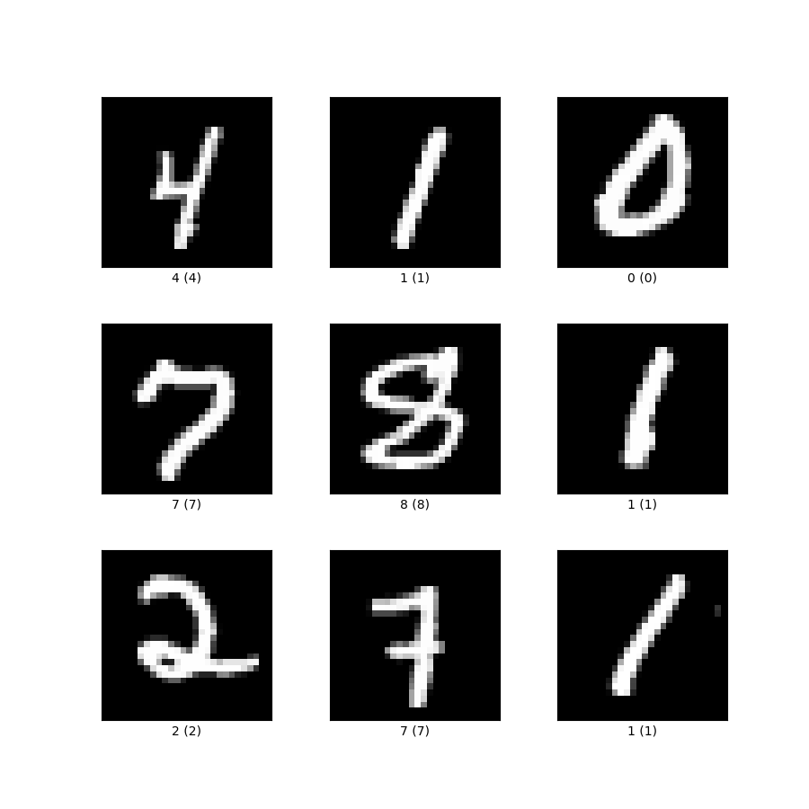
These images are divided into two sets:
Training set: 60,000 images
Test set: 10,000 images
Each image is a grayscale image of size 28x28 pixels, and each pixel value is an integer between 0 and 255, representing the intensity of the pixel.
Variable | Shape | Description
x_train | (60000, 28, 28) | 60,000 grayscale digit images
y_train | (60000,) | Labels (0–9) for training images
x_test | (10000, 28, 28) | 10,000 test images
y_test | (10000,) | Labels for test images

Slide 59
File Format
The MNIST dataset is stored in IDX file format, which is a simple format for vectors and multidimensional matrices of various numerical types.
The file format includes:
Magic number: An integer that indicates the type of data.
Size in each dimension: 4-byte integers that specify the size of the data in each dimension.
Data: The actual data stored in a C array-like format.

Slide 60
CNN with mnist dataset
import numpy as np
# Load the MNIST data from local file
data = np.load('mnist.npz')
lst = data.files
print(lst) #"['x_test', 'x_train', 'y_train', 'y_test']"
# data is a NumPy .npz file — it's not a tuple or list of tuples.
#It’s a dictionary-like object with named arrays.
#Not valid ---->>> (x_train, y_train), (x_test, y_test) = data
# Extract training and test sets
x_train = data['x_train']
y_train = data['y_train']
x_test = data['x_test']
y_test = data['y_test']
# Confirm shapes
##print("Train images:", x_train.shape) #(60000, 28, 28)
##print("Train labels:", y_train.shape) #(60000,)
##print("Test images:", x_test.shape) #(10000, 28, 28)
##print("Test labels:", y_test.shape) #(10000,)

Slide 61
# 1. Reshaping prepares the data for CNN input format.
# 2. Normalization improves training speed and stability.
# 3. One-hot encoding matches the output format of the final softmax layer in your CNN.
# CNNs expect input as (samples, height, width, channels)
# samples -1: placeholder (Figure this dimension out automatically)
# height and width: size of each image (28×28 pixels)
# channels: number of color channels, 1->grayscale 3->RGB
x_train = x_train.reshape(-1, 28, 28, 1) / 255.0
x_test = x_test.reshape(-1, 28, 28, 1) / 255.0
# / 255.0: px 0=black 255=white; Normalize pixel values to [0, 1] for better training
#Most optimizers (like Adam) perform better when inputs are in a small,
#consistent range, typically between 0 and 1
from tensorflow.keras.utils import to_categorical
# Converts integer LABELS (e.g., 5) into one-hot vectors:
# np.uint8(5) to array([0., 0., 0., 0., 0., 1., 0., 0., 0., 0.])
#This is needed for multi-class classification with softmax output
# y_train_cat.shape: (60000, 10) => 10 columns for digits 0–9
y_train_cat = to_categorical(y_train)
y_test_cat = to_categorical(y_test)

Slide 62
Concept | Explanation
CNN | A neural network that sees like a human — first edges, then shapes, then objects
MNIST | A dataset of handwritten digits (0–9)
Conv2D | Finds patterns in small image patches
Pooling | Shrinks image to reduce computation
Dense | Makes final prediction
Accuracy | How well the model predicts digits
Layer | Purpose | Output Shape
Conv2D | Detects patterns in image | (28, 28, 32)
MaxPooling2D | Shrinks image, keeps key info | (14, 14, 32)
Flatten | Converts 2D to 1D | (6272,)
Dense(64) | Learns complex features | (64,)
Dense(10) | Outputs digit probabilities | (10,)

Slide 63
from tensorflow.keras.models import Sequential
from tensorflow.keras.layers import Conv2D, MaxPooling2D, Flatten, Dense
##Conv2D: Finds patterns in small image patches (like edges or curves).
##MaxPooling2D: Shrinks the image to reduce complexity.
##Flatten: Turns a 2D image into a 1D list.
##Dense: A fully connected layer that makes decisions.
# You’re starting to build a stack of layers
model = Sequential([
Conv2D(32, (3,3), activation='relu', input_shape=(28,28,1)),
MaxPooling2D(2,2),Flatten(),
Dense(64, activation='relu'),Dense(10, activation='softmax')
])
Conv2D(32, (3,3)): Adds 32 filters (small 3×3 windows) that slide over the image to detect features like edges or corners.
activation='relu': Applies a function that keeps only positive values (helps the network learn better).
input_shape=(28,28,1): Each input image is 28×28 pixels, with 1 color channel (grayscale).
MaxPooling2D(2,2):
Looks at 2×2 blocks in the image and keeps only the strongest signal (the maximum value).
This shrinks the image and keeps the most important features.
Flatten(),
Takes the 2D image data and flattens it into a 1D list.
This is needed before feeding it into the final decision-making layers.
Dense(64, activation='relu’): A fully connected layer with 64 neurons.
Each neuron learns to recognize combinations of features (like loops, lines, etc.).
Uses ReLU to keep only positive signals.
🧠 Think of this as the brain of the model — learning how features combine to form digits.
Dense(10, activation='softmax’): Final layer with 10 neurons — one for each digit (0 to 9).
Softmax turns the outputs into probabilities that add up to 1.

Slide 64
model.compile(optimizer='adam', loss='categorical_crossentropy', metrics=['accuracy'])
model.fit(x_train, y_train_cat, epochs=2, validation_split=0.1)
# Adam optimizer adjusts weights efficiently.
# Categorical crossentropy is used for multi-class classification.
# Trains for 2 epochs (passes through the data 3 times).
loss, acc = model.evaluate(x_test, y_test_cat)
print("CNN Accuracy:", acc)
# Tests the model on unseen data.
# Prints accuracy (usually >98% for MNIST!)

Slide 65
🔄 6. Recurrent Neural Networks (RNN)
🔧 Structure:
Has loops: output from previous time step feeds into the next
Maintains memory of past inputs
Can be unrolled over time
🧠 Key Idea:
Learns sequences and temporal patterns
📦 Use Cases:
Time series forecasting
Natural Language Processing (NLP)
Speech recognition
An RNN (Recurrent Neural Network) is a type of neural network that is great at handling sequential data — like time series, speech, or text.
🧠 Analogy:
Imagine you're trying to predict the next word in a sentence. You need to remember the previous words to make a good guess. RNNs do exactly that — they remember past inputs while processing new ones.

Slide 66
import pandas as pd # Step 1: Load and preprocess data
df = pd.read_csv('stock_prices.csv')
prices = df['close'].values.reshape(-1, 1) #Reshapes the data into a column vector.
from sklearn.preprocessing import MinMaxScaler
# Step 2: Normalize prices
#Normalizing helps the model learn patterns more effectively and converge faster.
scaler = MinMaxScaler()
prices_scaled = scaler.fit_transform(prices)
import numpy as np
# Step 3: Create sequences
def create_sequences(data, seq_len):
X, y = [], []
for i in range(len(data) - seq_len):
X.append(data[i:i+seq_len])
y.append(data[i+seq_len])
return np.array(X), np.array(y)
seq_len = 30 # Use last 30 minutes to predict next
X, y = create_sequences(prices_scaled, seq_len)
X = X.reshape(-1, seq_len, 1) #(samples, time steps, features)
y = y.reshape(-1, 1)
Future Price Prediction

Slide 67
# Step 4: Train/test split
#Splits data into training (80%) and testing (20%) sets.
split = int(len(X) * 0.8)
X_train, X_test = X[:split], X[split:]
y_train, y_test = y[:split], y[split:]
from tensorflow.keras.models import Sequential
from tensorflow.keras.layers import Input, SimpleRNN, Dense
# Step 5: Build RNN model
model = Sequential([
Input(shape=(seq_len, 1)), #30 time steps, 1 feature.
SimpleRNN(32, activation='tanh'), #Core RNN layer with 32 units.
Dense(1) #single value — the predicted next minute’s price.
])
##adam optimizer: Efficient gradient descent.
##mse loss: Measures how far predictions are from actual prices.
##epochs=10: Trains the model 10 times over the dataset.
##batch_size=32: Processes 32 samples at a time.
model.compile(optimizer='adam', loss='mse')
model.fit(X_train, y_train, epochs=10, batch_size=32, verbose=1)

Slide 68
# Step 6: Predict next minute price using the trained RNN
last_sequence = prices_scaled[-seq_len:].reshape(1, seq_len, 1)
next_scaled = model.predict(last_sequence)
next_price = scaler.inverse_transform(next_scaled)
print("Predicted next minute close price:", next_price[0][0])
import matplotlib.pyplot as plt
# Step 7: Plot actual vs predicted (optional)
y_pred = model.predict(X_test)
y_pred_rescaled = scaler.inverse_transform(y_pred)
y_test_rescaled = scaler.inverse_transform(y_test)
plt.plot(y_test_rescaled, label='Actual')
plt.plot(y_pred_rescaled, label='Predicted')
plt.title("RNN: Minute-Level Stock Price Prediction")
plt.xlabel("Time Steps")
plt.ylabel("Price")
plt.legend()
plt.show()
Step | Purpose
Extract last 30 minutes | Create input for prediction
Predict next value | Use trained RNN to forecast
Inverse scale | Convert back to real price
Print result | Show the predicted close price

Slide 69
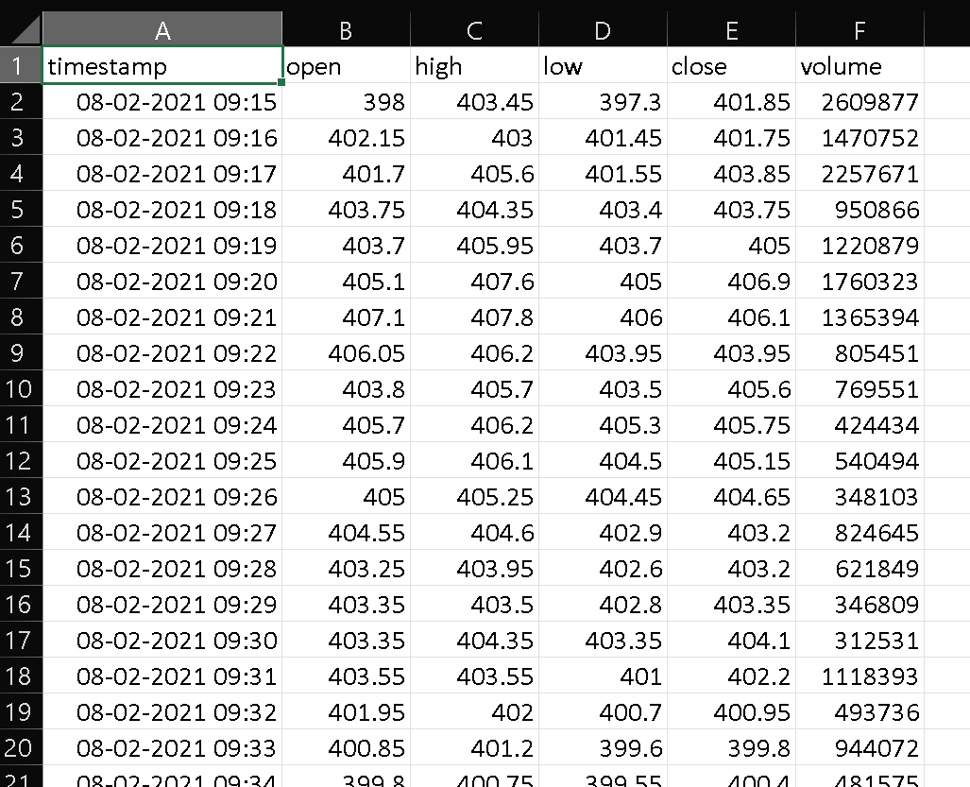
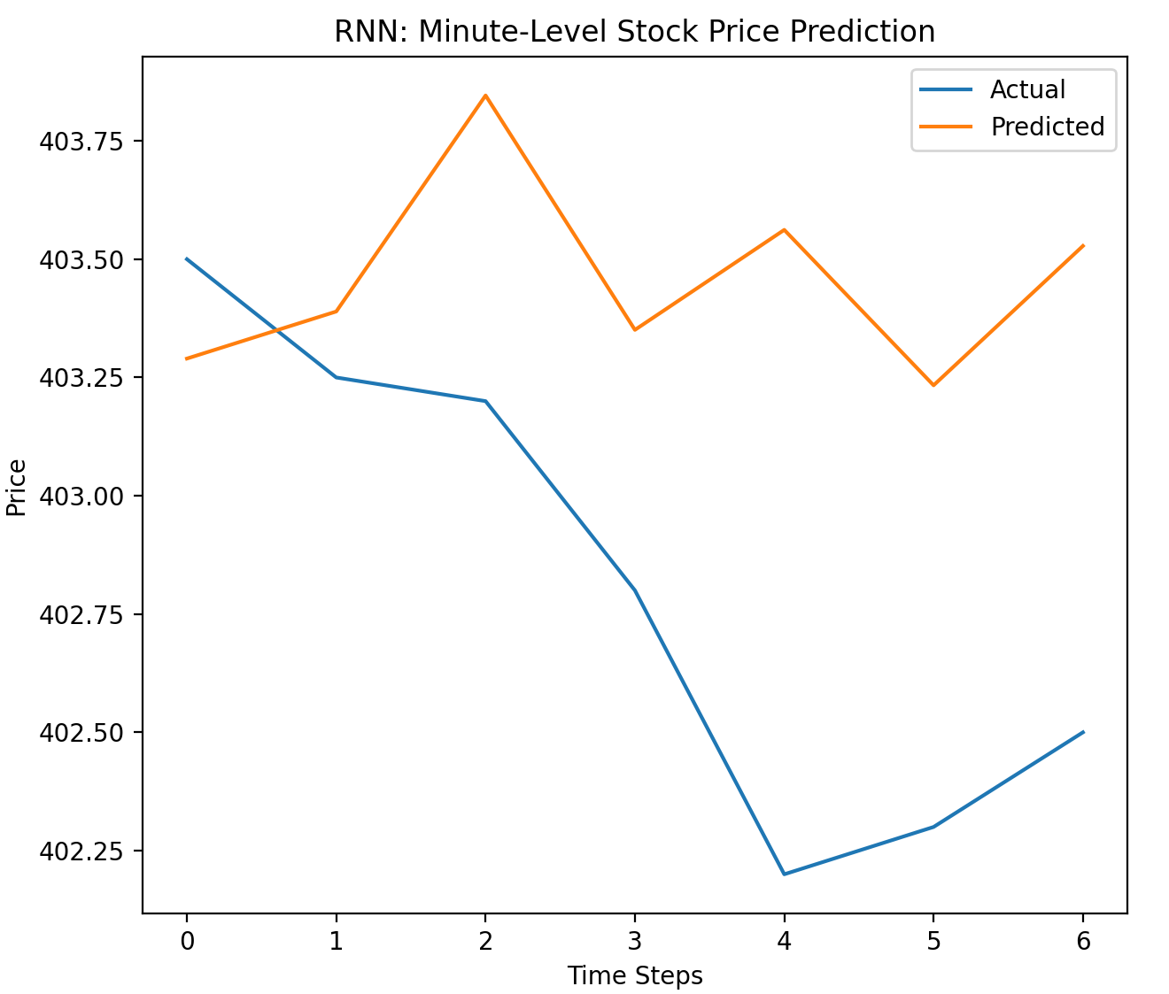
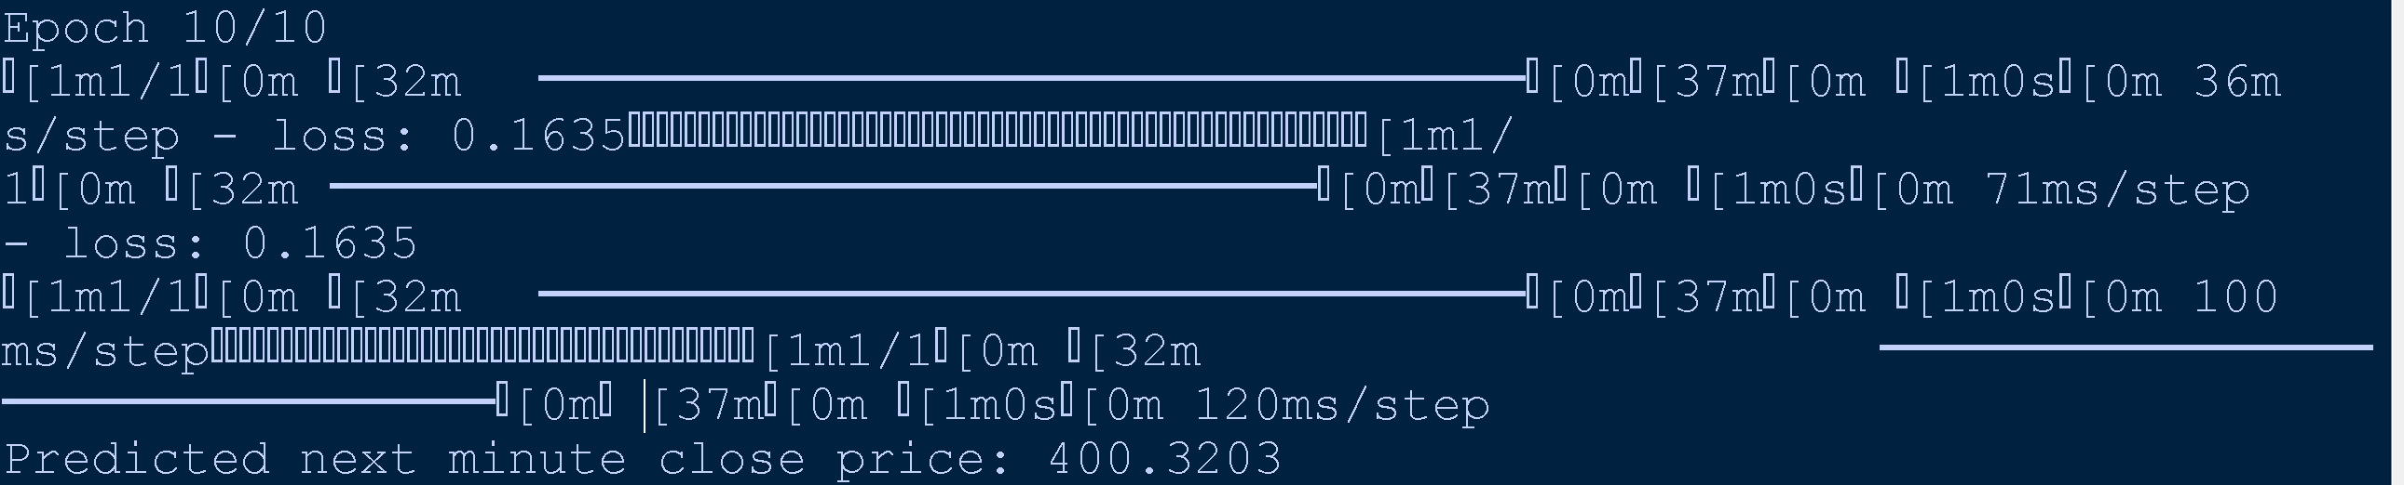

Slide 70
🔍 What the Graph Tells You
✅ Trend Matching: The predicted line captures the overall direction — it rises when the actual rises and falls when the actual falls.
❌ Deviation: The predicted values are not perfectly aligned — especially around minute 2–4, where the actual price drops sharply but the prediction lags.
🧠 This is typical for simple RNNs — they can learn short-term patterns, but may struggle with sharp turns or noise.
🧠 How to Improve Accuracy
If you want the orange line to hug the blue line more tightly:
Switch to LSTM or GRU for better memory of past trends.
Add more features like volume, moving averages, or price change rate.
Train on longer sequences or more data.

Slide 71
🔍 Summary Table
Feature | FNN | CNN | RNN
Data Flow | One-way (no memory) | One-way (spatial filters) | Loops (temporal memory)
Best For | Tabular data | Images, spatial data | Sequences, time series, text
Learns From | Feature combinations | Local patterns (e.g., edges) | Temporal dependencies
Layers Used | Dense | Conv2D, Pooling, Dense | RNN, LSTM, GRU, Dense

Slide 72
Thank you

